Slide 1
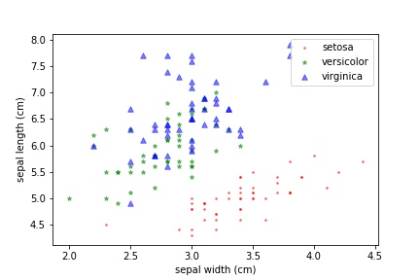
Main purpose is to visually show the distribution of the data points, making it easier to spot correlations and relationships.
The most important part is to make sure different data sets are easily distinguishable and color/size may be used to represent density of data.

